Slide 1
MODULE – V Traditional Knowledge in Professional domain

Slide 2
Town planning and architecture
It reflect deep-rooted principles of sustainability, community, spirituality, and harmony with nature. These systems, often overlooked in modern urban development, offer valuable insights into creating livable, resilient, and culturally meaningful settlements.
Arthashastra in Town Planning
Arthashastra, attributed to Kautilya (Chanakya) around the 4th century BCE, is a foundational Indian treatise on statecraft, economics, and military strategy. It also offers one of the earliest documented frameworks for urban planning and architecture in ancient India. The town planning ideas in the Arthashastra are remarkably systematic, functional, and ahead of their time.
Aspects of Town Planning in the Arthashastra
1. Site Selection
Towns should be located near natural resources (water, fertile land, forests).
Emphasis on strategic defensibility and trade routes.
Consideration of climatic conditions and disease avoidance.

Slide 3
City Structure and Layout
Fortification: Cities were to be fortified with ramparts, moats, and gates. The fort (durga) was the nucleus of the city.
Rectangular Grid System: The Arthashastra recommends a regular layout, often interpreted as a grid-based plan — straight roads intersecting at right angles.
Zoning:
Residential zones for different castes and professions.
Market areas placed centrally for accessibility.
Administrative zones for state offices, treasuries, and the palace.
Military zones for barracks, weapon stores, and guard towers.
3. Infrastructure and Utilities
Roads: Well-planned wide roads and smaller lanes; importance of cleanliness and maintenance emphasized.
Water Management:
Construction of wells, canals, reservoirs, and drainage systems.
Rainwater harvesting encouraged.
Waste Management: Arthashastra prescribes designated areas for waste disposal and strict penalties for public littering or pollution.

Slide 4
4. Safety and Surveillance
Watchtowers and secret agents to monitor crime, corruption, or rebellion.
Residential registers and movement tracking within the town.
5. Public Amenities
Hospitals, schools, temples, and gardens were recommended as part of public planning.
Markets regulated for fair trade, weights and measures.
6. Disaster Preparedness
The city should be prepared for fire, floods, enemy attack, and famine — including maintaining emergency stores of grain and arms.

Slide 5
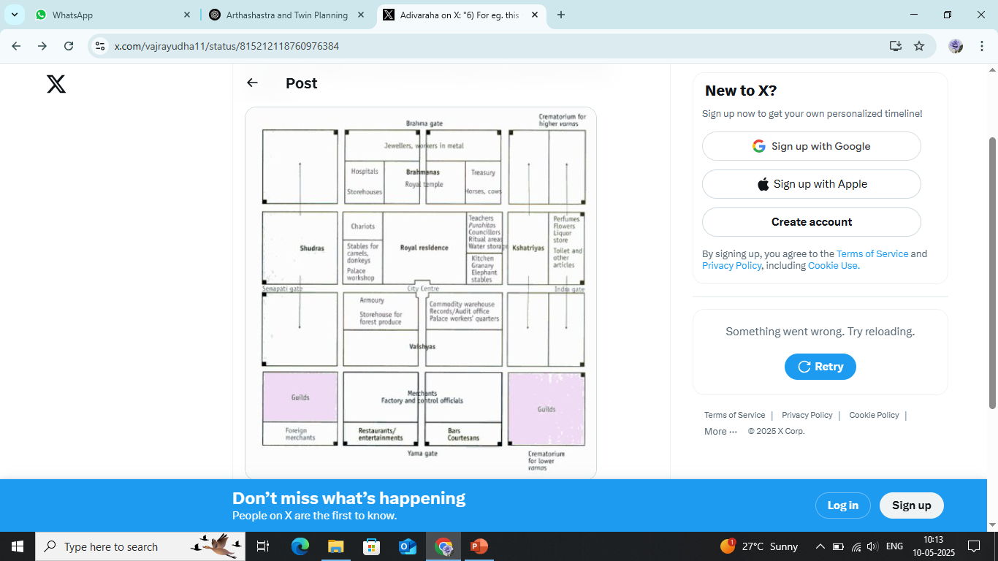

Slide 6
Raja Dharma (Arthashastra)
Raja Dharma in the Artha Shastra refers to the duties and responsibilities of a king as described by Kautilya (also known as Chanakya or Vishnugupta). The Artha Shastra, written around the 4th century BCE, is a foundational text of political science and governance in ancient India. "Raja Dharma" specifically focuses on the ethical and administrative obligations of the ruler in maintaining order, prosperity, and justice.
Raksha
Vyavahara
Palana
Kosha
Danda Niti
Espionage and Diplomacy
Advisor and Ministerial Governance
Moral Conduct and Self-Discipline

Slide 7
Comparison of Raja Dharma in Arthashastra vs Manusmriti
Aspect | Artha Shastra (Kautilya) | Manusmriti (Manu)
Nature of the Text | Secular, pragmatic treatise on politics and economics | Religious-legal code rooted in Dharma (moral law)
Focus of Raja Dharma | Practical governance, administration, and statecraft | Upholding Dharma, caste duties, and moral justice
Role of the King | Strategic ruler focused on law, order, prosperity, and power | Moral and spiritual guardian enforcing divine law
Justice (Vyavahara) | Justice serves state stability; based on evidence and reason | Justice must align with Dharma Shastras and caste laws
Use of Punishment (Danda Niti) | Central to maintaining order and discipline; scientifically applied | A divine tool to protect righteousness and deter sin
Welfare of the People | Economic development, fair taxation, infrastructure | Ensure moral order and caste-based duties
Spying and Espionage | Encouraged as a key tool of internal and external control | Not emphasized; considered morally questionable
Military and Diplomacy | Realpolitik: war, alliances, espionage based on state interest | Emphasis on righteous war (Dharma Yuddha)
Ministers and Counsel | Governance through trained advisors and experts | Advisers should be Brahmins; spiritual wisdom valued
Religious Role of King | Minimal; religion is secondary to political power | Strong; king must uphold Vedic rituals and Brahmin supremacy
Taxation and Revenue | Taxes based on productivity; economy-centric | Taxes should maintain Brahmins and societal order

Slide 8
Kautilya Arthashastra
The administrative setup in Kautilya’s Artha Shastra is one of the most detailed and sophisticated models of governance found in ancient Indian literature. It outlines a centralized, hierarchical bureaucracy designed to ensure efficient governance, control, and economic prosperity.
Raja
Mantri Parishad
Amatyas
Tirthas
Provincial Administration
District and Village Administration
Gudhapurusha
Justice System
Revenue and Taxation

Slide 9
Health and Disease treatment on Unani
Unani is based on four bodily humors (Akhlat), and health is defined as the balance of these:
Dam (Blood) – Hot & Moist
Balgham (Phlegm) – Cold & Moist
Safra (Yellow Bile) – Hot & Dry
Sauda (Black Bile) – Cold & Dry
Each person has a temperament (Mizaj) influenced by these humors, and treatment aims to correct imbalances.

Slide 10
Tahaffuz-e-Sehat
Ilaj
Ilaj bil Tadbeer
Ilaj bil Ghiza
Ilaj bil Dawa
Ilaj bil Yad
3. Humma
The Unani system maintains health through lifestyle regulation and natural balance, and treats disease by restoring humoral equilibrium using:
Preventive care (Six essentials)
Natural treatments (diet, regimen, drugs)
Emphasis on individual temperament and balance

Slide 11
Indian Epics- Public Administration
Ramayana
Mahabharata
Theme | Description
Dharma (Ethical Duty) | Rulers must uphold righteousness above personal gain.
Rajadharma (Duty of Kings) | Protect people, punish the wicked, and ensure justice and prosperity.
People-Centric Governance | Welfare of citizens is central; rulers are servants of the people.
Advisor System | Emphasis on wise counsel (e.g., Vasishtha, Vidura, Bhishma).
Decentralization | Local administration and village-level self-governance are encouraged.
Accountability | Kings are answerable to divine law, sages, and public conscience.

Slide 12
Ancient India- Treasury and State Economy
In Ancient India, the treasury (Kosha) and state economy were crucial elements of governance, especially as described in texts like the Artha Shastra, Manusmriti, and the Indian epics. The system was well-organized, revenue-driven, and linked closely with agriculture, trade, and ethical governance.

Slide 13
1. The Treasury (Kosha)
The Kosha was the financial backbone of the kingdom.
It was maintained by the king, advised by the Koshaadhyaksha (Superintendent of Treasury).
Funds were used for:
Military expenses
Infrastructure (roads, irrigation)
Public welfare
Salaries of officials
Diplomatic missions and festivals

Slide 14
Source | Description
Land Revenue (Bhaga) | Main source; share of agricultural produce, usually 1/6th.
Trade and Commerce Taxes | Customs duties, tolls, and merchant taxes.
Mines and Forests | Revenue from minerals, salt, and timber.
Tributes and Fines | Payments from vassal states and judicial fines.
Cattle and Animal Wealth | Taxes on livestock and dairy.
State Monopolies | Salt, alcohol, metals, and arms production.

Slide 15
State Economy
The economy was agrarian, but also supported by trade, crafts, and industry.
Emphasis on self-sufficiency, local production, and ethical trade.
Sector | Features
Agriculture | State invested in irrigation, seeds, and land reforms.
Industry and Crafts | State promoted weavers, blacksmiths, potters through guilds (Shrenis).
Trade (Vanijya) | Both inland and maritime trade flourished. Ports like Lothal and Bharuch were vital.
Banking and Loans | Moneylenders existed; interest rates were regulated by law.
Coinage | Coins (e.g., punch-marked coins) made of silver, gold, and copper were in circulation.

Slide 16
Management and Accountability
Auditors ensured that state funds were not misused.
Regular inspections of treasuries, markets, and granaries.
Punishment for embezzlement was severe under Kautilya’s system.
Surplus was stored in emergency reserves for famines or wars.
Philosophy of Economy
Economy served the Dharma of the ruler: welfare of subjects.
A prosperous state was seen as one where people are productive, taxes are fair, and the treasury is full.

Slide 17
Siddha System for Treating Human Diseases
Siddha medicine is based on the belief that the body is composed of the five elements (Panchabootham):
Earth (Prithvi)
Water (Appu)
Fire (Thee)
Air (Vayu)
Space (Akasam)
These elements combine to form three humors (Mukkuttram) that govern bodily functions:
Vatham (Air + Space): Controls movement.
Pitham (Fire): Governs metabolism and digestion.
Kapham (Earth + Water): Maintains stability and structure.
Health = Balance of Mukkuttram Disease = Imbalance of Mukkuttram

Slide 18
Diagnosis (Noigal Neralvu Murai)
Diagnosis is both physical and spiritual and includes:
Pulse reading (Nadi Pariksha)
Observation of tongue, eyes, urine, stool, voice, and skin
Evaluation of patient’s lifestyle and temperament (Udal Kattugal)
Treatment Principles
Unavu Maruthuvam
Mooligai Maruthuvam
Thathu Maruthuvam
Yoga and Kayakalpa
Sirappu Maruthuvam
Varmam and Uzhichil
Parpam, Chendooram
Dinacharya and seasonal routine Ritucharya

Slide 19
Kautilya's Artha Shastra-Saptaanga
No. | Element (Sanskrit) | Meaning / Role in Governance
1. | Swamin (The King/Ruler) | The head of the state who governs according to Dharma; responsible for security, justice, and welfare.
2. | Amatya (Ministers/Officials) | Well-trained advisors and administrators who assist in governance and policy execution.
3. | Janapada (Territory & People) | The land and its population; includes citizens' welfare, productivity, and protection.
4. | Durga (Fortified Capital) | The administrative and military center; emphasizes town planning, defense, and infrastructure.
5. | Kosha (Treasury) | State finances; supports administration, welfare programs, defense, and economic development.
6. | Danda (Law and Force) | The system of justice and law enforcement; ensures order through fair punishment and discipline.
7. | Mitra (Ally) | Foreign relations and diplomacy; allies support defense, trade, and political stability.

